Slide 1
Open Event Machine
Multicore Processor Business Unit
Application Team
August 2012

Slide 2
Agenda
Motivation for the OpenEM
Understanding OpenEM and TI Implementation
TI Example Code
Benchmarks

Slide 3
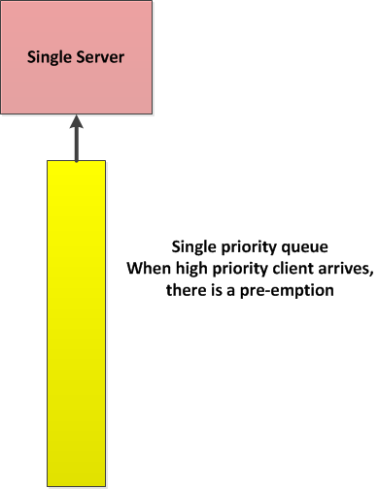
Traditional Operating System – Single Server Single Queue
Real-time operating system involved context switching
Cycles are spent on managing all the task and on the context switching
Possible of race conditions or other bugs

Slide 4
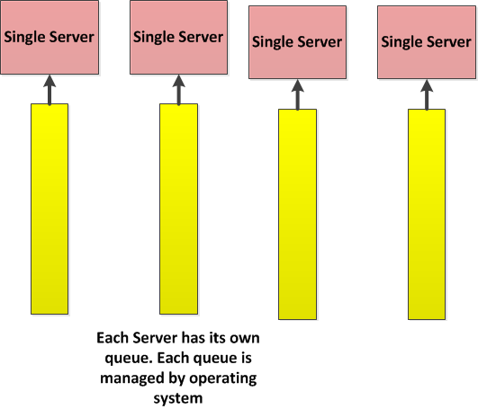
Multicore Operating System – Multiple Servers Multiple Queues
Each core is controlled by Individual real-time operating system. Context switching and task management still cost cores’ cycles

Slide 5
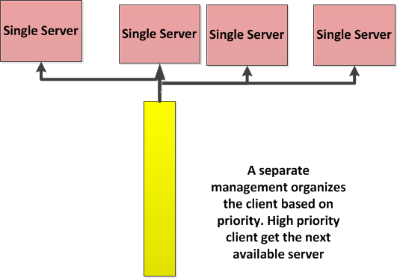
Event Machine– Multiple Servers Single Queue
Event runs to completion on each Server
There are many servers so some server will complete an event fast, result in small delay for high priority event
For robust system, events are chosen to have small execution
The management operation is done by a special logic (PDSP). Cores do not spend cycles on operating system or context switching

Slide 6
Agenda
Motivation for the OpenEM
Understanding OpenEM and TI Implementation
TI Example Code
Benchmarks

Slide 7
Basic job execution is no longer based on threads. It is now based on events. Events are a small granularity of execution that include associated data. Open Event Machine (Open EM) is a centralized runtime system that distributes events between system resources.
Major Paradigm Shift

Slide 8
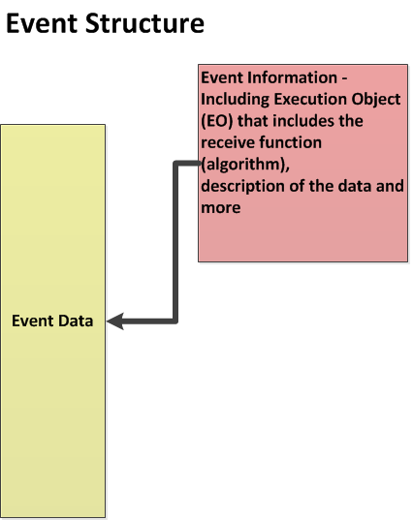
Event – A Software Structure
Examples of Events:
Voice processing when enough data arrives
Second stage of video processing (or any other multi-stage task)
Events are implemented by descriptors in the multicore Navigator system (Host descriptors and monolithic descriptors)
Receive function is a function pointer to the processing algorithm. It is part of the Executable Object (EO) structure that is part of the Event

Slide 9
Event Machine Distributes Events
The purpose of the Event Machine is to distribute events between multiple processing elements (i.e. cores, accelerators, co-processors) in an efficient way.
Typical processing case - many events run the same algorithm on different data package. The number of algorithms is limited, the number of different data is not.
Different events might have different priorities.

Slide 10
Open Event Machine Concept
It is an open source (BSD license)
http://sourceforge.net/projects/eventmachine
The download has standard API and reference implementation.
The main elements of OpenEM are the following:
Events
Execution Objects (EO)
Queues
Scheduler
Dispatcher
Event Pool
Flow
The next few slides cover each of the elements

Slide 11
The EO and the Event
The EO includes the receive function – That is, the algorithm that is associated with the event, and all the constants, tables etc. that are part of the event execution.
The Event has the data to be processed and an indicator of which EO to call for this data.
Not all cores have the same EO (more discussion later) and obviously co-processors and accelerators have limited functionality.

Slide 12
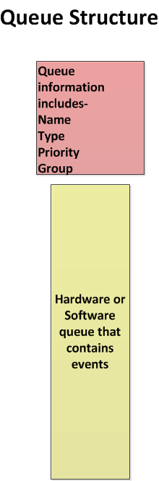
Queue – A Software Structure
Queues Attributes:
Type – Atomic or Parallel
Priority
Group – what processing elements (cores, accelerators) the queue supports
Software queues use navigator hardware queues to manage events. These queues are call private queues (private to the Event Machine)

Slide 13
Event Pools
Each event belongs to a pool.
There are one or more event pools in the system.
The event pool specifies the attributes of the events:
Type (monolithic or host)
Size
Buffer
Where to free the event after usage

Slide 14
Flows
Flows manage receiving events
Just as the event pool combines descriptors with free descriptor queues, flow combines the receive queue and RxFlow.

Slide 15
The Dispatcher Function
Each processing unit has a dispatcher function.
The dispatcher functions include the following:
Communicates with the scheduler
Gets the next event to process
Processes the event
TI implementation of core dispatcher is called ti_em_dispatch_once();
If no event is available, the routine returns (No blocking)
Dispatching modes:
Run-to-completion
The event execution time needs to be bounded in order to control the latency. Latency improves as more processors are involved.
Co-operative
Working on a co-operative dispatcher based on the co-routines (Portable Co-routine Library). This should allow support for more concurrency patterns (e.g. nested loops and tasks in OpenMP 3.0). For synchronous schedulers only.

Slide 16
More about ti_em_dispatch_once
The ti_em_dispatch_once() operation does the following:
Reads the event
Identifies the data address
Calls the EO that is associated with the event
If this is an illegal EO, it reports an error.
To speed up the processing, the ti_em_dispatch_once() operation calls ti_em_preschedule() to asks the scheduler for the next event before calling the EO function
ti_em_preschedule() and ti_em_dispatch_once() are part of TI OpenEM implementation

Slide 17
Dispatcher – Example code
int main(void) {
...
while(1)
if (ti_em_dispatch_once()!=EM_OK) my_handle_false_dispatch();
... }
em_status_tt ti_em_dispatch_once(void) {
...
if((lvEventHdl=fetch_event())==EM_EVENT_UNDEF) return TI_EM_ERR_NOT_FOUND;
...
receive(lvEventHdl,...);
...
return EM_OK; }

Slide 18
Central Logic – The Scheduler
The scheduler decides which processing element gets what event.
The OpenEM API does not specify the implementation.
TI considers two implementations:
Core-based implementation
Navigator-based implementation
This presentation only considers Navigator-based implementation
The scheduler code is developed by TI and it runs on PDSP RISC processors that are part of the Navigator Queue Manager Subsystem (QMSS).

Slide 19
Scheduler Algorithms
The scheduler selects an event on request of a core
Scheduling criteria
Priority: Events have precedence over lower-priority events.
Each event queue has a priority.
Atomicity: Events from locked atomic event queues are discarded.
An event queue is either parallel or atomic. Unlike a parallel event queue, an atomic event queue does not allow that a processor starts the processing of a event from this event queue as long as another processor is processing another event from this event queue. Atomic event queues offer lock-free protection to a shared resource.
Locality: Events from masked event queues are discarded.
Event queues can be statically associated with one, some or all processors. Event queues that are not associated with the requesting core are masked.
Order: Events have precedence over younger events.
Scheduling modes
Asynchronous: The scheduler runs on a different processor in the background.
Synchronous: The scheduler runs on the requesting core in the foreground.
Not yet implemented

Slide 20
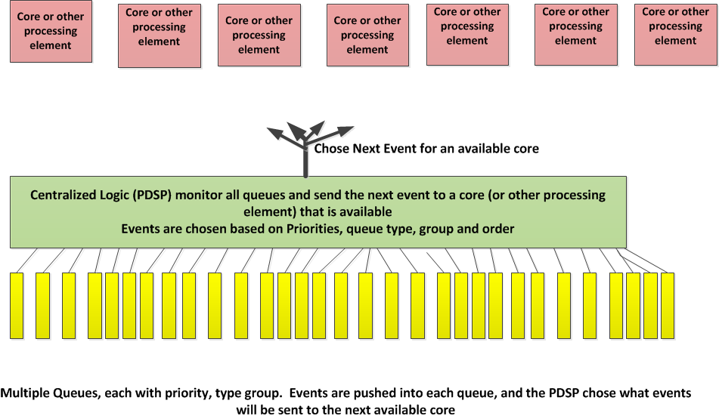
Centralized Logic Assigns Events to Cores

Slide 21
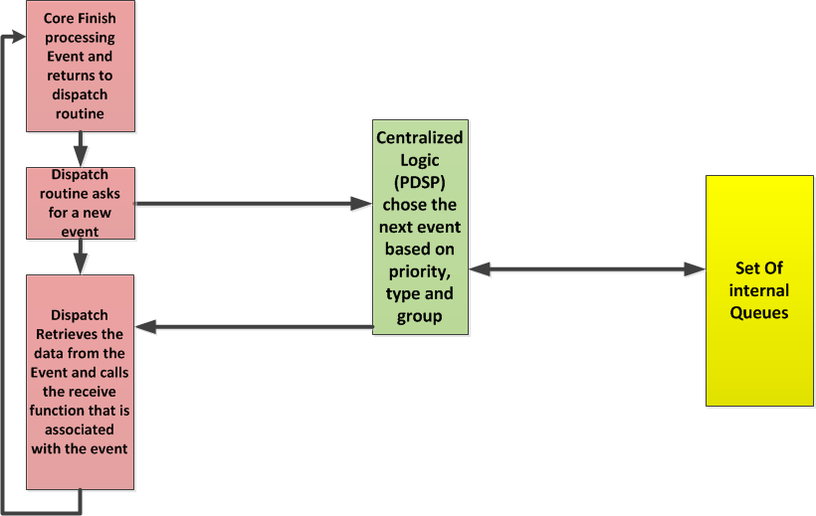
Processing of a New Event

Slide 22
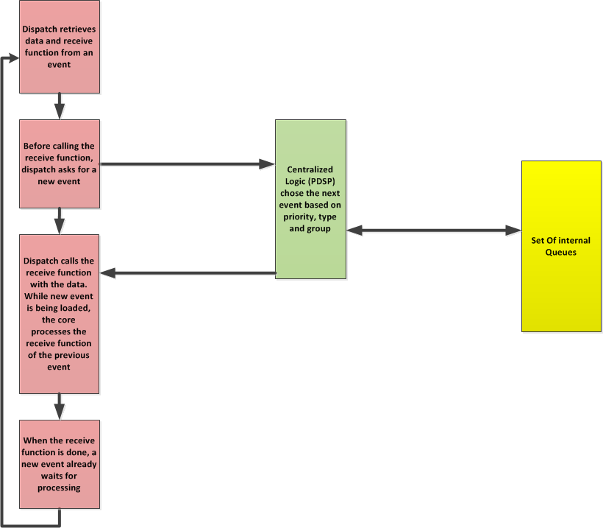
Pre-load an Event

Slide 23
Creating a New Event
Pre-requisite for a new event – available data and a known function to process the data:
Gets an event from event pool using em_alloc() function
Puts the data inside the event (or the buffer that is associated with the event)
Loads the event with the EO to be used
Sends out the event using em_send() to a queue
The event machine will deliver the event to an appropriate core receive queue

Slide 24
Processing an Event
When the processing of a previous event is done, the dispatcher code does the following:
Gets the next event from the Event Machine
Gets the data from the event
Calls the function associated with the EO with the data
Notifies the Event Machine when processing is done
During run time, all the above operations are performed by the dispatcher using standard API (part of the OpenEM). So the user does not need to develop these functions
If pre-load is used, the event machine loads the next event (data and all) to the core while the current event is being processed by the core

Slide 25
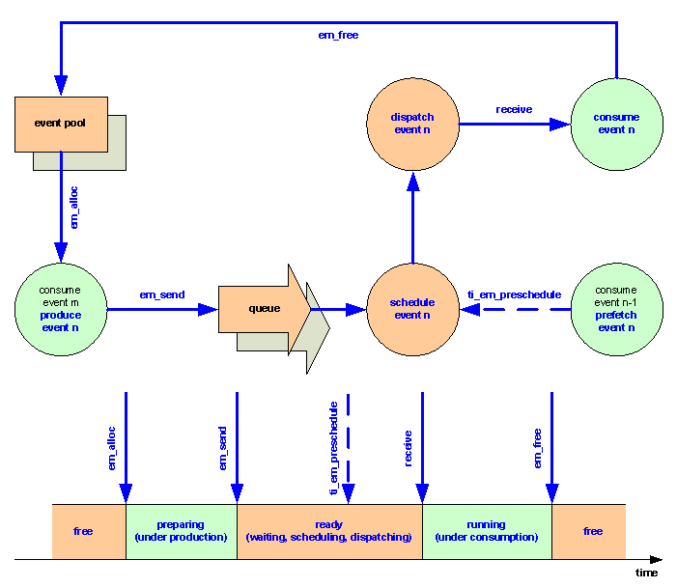
Event Life Cycle

Slide 26
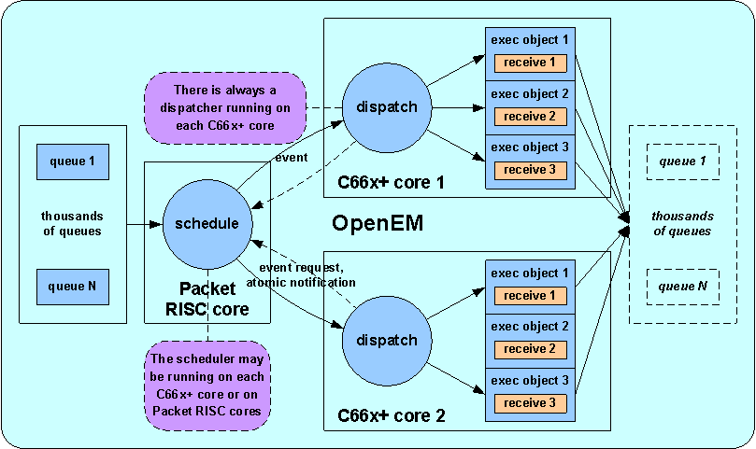
Putting It All Together

Slide 27
Schedule Example 1
Scenario: C6678-based (8x CorePac) device performs voice processing for two applications:
Telephone conversation
Recoding device
Data arrives by channels; Each channel is pre-defined to support one of the above applications.
When there is enough data per channel, an event is generated (more discussion later) and is pushed into a queue.
There are two queues:
Queue 1 = high priority << Telephone conversation data events are pushed here
Queue 2 = low priority << Recoding data events are pushed here
Both queues are parallel (not atomic)
Both queues belong to one group; The group mask is configured such that all eight CorePacs can get events from either one of the queues.
Result: Telephone conversation data will always be processed before recoding data

Slide 28
Schedule Example 2
Scenario: Multi-channel video encoding application running on C6678 device
Each video processing routine involves two tasks – motion estimation and video compression (all other compression processing).
Video compression of a channel cannot start before motion estimation is done.
All channels have the same priority.
As each new data of a frame (of a channel) arrives, the system dynamically creates an atomic queue and pushes two events; One for the motion estimation task and one for the compression task. This ensures that compression will not start before the end of motion estimation.
When processing ends (after the end of the compression event), the queue is deleted.
All other queue parameters – priority, group, etc. – are the same.

Slide 29
Schedule Example 3
Scenario: Application processing of 1M FFT on a C6678 device.
The algorithms runs in two iterations:
In the first iterations,1024 independent FFT (each one of size 1024) are implemented, and the results are written back to the DDR with transpose.
The second iteration does 1024 FFT (each one size 1024) after multiplying by a twiddle factor.
The second iteration cannot start until all FFT from the first iteration are complete.

Slide 30
Schedule Example 3 – Possible Solution
Note that there are better ways to solve this problem.
One possible solution is having two parallel queues with the same group (mask enables all cores) but with different priorities – high and low.
Eight more queues – each with a separate group, each group mask enables only one core – are defined with medium priority.
At start up, all first iteration events are pushed into the high priority queue, and the second iteration events are pushed into the low priority queue.
Eight (or the number of cores that are participate) communication events are pushed into the medium queues – one for each queue.
The function that is connected to the communication event does the following –
Send 7 messages, one to each core (except to itself)
Wait to receive 7 messages and then exit

Slide 31
OpenEM features -Load Balancing
An important mission of OpenEM is to balance the load of the cores
There are two distinct strategies to achieve load balancing
Eager: The runtime selects a core when an event is produced. For this purpose, the runtime would have to provide an explicit load balancer.
Lazy: The runtime selects a core when this core is ready (soon) to consume an event. As load balancing is implicit, there is no need for a load balancer.
OpenEM tries to be as lazy as it can be (;-). The application (or other runtime using OpenEM) can be eager if it wants to.
OpenEM supports static load balancing as well!
It allows gradually moving from static to dynamic load balancing with minimal changes to the user code.

Slide 32
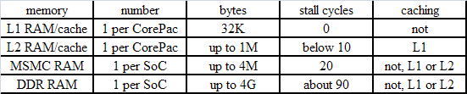
OpenEM Memory Management
Non-uniform
Event buffers are typically mapped to global shared memory (MSMC/DDR RAM) and cached in local private caches (L2/L1)
Cache coherency (event option) and memory consistency
OpenEM allows invalidating read event buffers in cache when an event is freed
OpenEM allows writing back written event buffers to memory and invalidating them in cache when an event is sent
OpenEM raises memory fences and flushes prefetch buffers whenever needed!
Pre-loading (event option) and post-storing
OpenEM allows pre-loading scheduled events from global shared memory (MSMC/DDR RAM) to local private memory (L2/L1 RAM). Pre-loading can be truncated.
OpenEM allows post-storing produced events from local private memory (L2/L1 RAM) to global shared memory (MSMC/DDR RAM). Not yet implemented.
Benefits: Less (possibly zero) read/write stalls, HW-managed cache coherency operations (no overhead), HW-managed gathering and scattering of event payloads (no overhead)

Slide 33
Seamless Integration
With HW
Efficient interworking with HW consumers and producers
Similar programming model as for SW consumers and producers
Accelerators: FFTC, BCP, ...
Interfaces: Ethernet, SRIO, AIF, ...
With RTOS
RTOS brings pre-emption into the picture
OpenEM running with no, one or multiple RTOS simultaneously, for instance
Bare metal on Corepac 0 and 1
With OS A on Corepac 2
With OS B on Corepac 3

Slide 34
A Few More Words about OS integration
OpenEM dispatcher runs in one or more (*) OS threads on each core.
High priority thread: OpenEM yields to low priority if no events.
Low priority thread: OS pre-empts when high priority thread wakes up.
(*) Support for running in two or more OS threads not yet released
Load-balancing scheduler
DSP CPU 0
DSP CPU 1
DSP CPU 2
thread
OpenEM
Dispatcher
NRT
dispatcher
OpenEM
Dispatcher
OpenEM
Dispatcher
thread
NRT
dispatcher
NRT
dispatcher
thread
thread
OpenEM
Dispatcher
OpenEM
Dispatcher
NRT
dispatcher
NRT
dispatcher
thread
thread
thread
thread
thread
thread
RTOS
RTOS
RTOS
driver
driver
IPC
driver
driver
IPC
driver
driver

Slide 35
Agenda
Motivation for the OpenEM
Understanding OpenEM and TI Implementation
TI Example Code
Benchmarks

Slide 36
TI Example 0
Before starting, CorePac 0 generates 1024 FFT processing events with different FFT sizes and pushes them to the queues using em_send(). Then CorePac 0 joins the other seven CorePacs in processing FFT.
FFT event (all cores)
Processing FFT as it comes from the scheduler
Generate an event to validate the results
SinK event (all cores)
Validating the result – compares the FFT with reference data
Do statistics
Exit event (core 0)
When all other events consumed, the Exit event is run by CorePac 0 to summarize the statistics and tell all other cores to exit.

Slide 37
Generic System Configuration
My_initMemLocal()
Run by all cores
Configures the cache-ability and prefetch-ability of memory areas that will be used
TI example sets the cache sizes, and disables cache for part of MSM (L2 shared memory)
My_initMemGlobal
Runs only on one core
Configures the DDR access and the Teranet (VBUS)
Configures the SES and SEM MPAX registers to agree with the local memory setting
Usually done by the boot code or the gel file

Slide 38
OpenEM and Navigation Configuration
The configuration is done in two steps:
A structure is built with configuration information.
LLD or other API configure HW with the structure that was built previously.
What is configured?
Pools, Regions, and Events
Queues
PDSP firmware, QMSS and CPPI modules
Internal OEM elements (queues, infrastructure PKTDMA)

Slide 39
TI Example0: Pools, Regions, & Events
10 pools are defined:
One for regular events (2048 events)
One for exit event (8 events)
Eight for each core pre-load event (2 events for each core)
Each pool has a free queue, buffer size that is associated with the events in the pool, free policy, … and so on.
10 Regions are defined – each corresponds to a pool. Descriptors are allocated in the region according to the number of the pool event.
Regions are inserted by ascending address order and descriptors are generated and attached to events.

Slide 40
TI Example0: Queues, Firmware & Navigator
Free queues are opened. Before events pushed in, verify that the queues are empty.
All other queues are manages by the OpenEM system. The configuration of these queues is done partially by the core code (define which queues are used by the OpenEM system), but most of the configuration is done by the OpenEM code (more about this later).
Firmware is loaded to one or more PDSP. In the example, only one PDSP has firmware. Real applications might need the second PDSP, as well.
Standard QMSS and CPPI initialization is performed (Qmss_init, Qmss_start, Cppi_init).

Slide 41
Internal OEM Element Configuration
The ti_em_init_global() is a standard TI implementation routine that performs the OpenEM internal configuration.
The user DOES not change this routine. The parameters for this routine are built from all the previous steps.
The routine defines and configures all the private queues that are used for ALL OpenEM operations, regardless of which features are used in any example.
All infrastructure PKTDMA Tx and RX channels are configured, as well.
All infrastructure PKTDMA Rx Flow are also configured as free policies of DMA channels and events.

Slide 42
Navigation Configuration - Local
Each core must call my_em_initLocal
em_status_t ti_em_init_local ( void )
Local initialization of EM internals.
All cores call this and it must be called after em_init_global(), but before any other call. Implementation may be actually empty, but this might be needed later for some core specific initializations. So application startup should call this always.
This call initializes individual queues for each core. Then a NULL descriptor is pushed into each queue.

Slide 43
Local Time Configuration
Using my_initClockLocal() enables the system to consolidate time stamp from all cores

Slide 44
Send a New Event Define an Event and Send It
Using em_alloc() with size, event type and pool ID to get a pointer to a new (host) descriptor from the free queue that is associated with the pool, load some initial parameters into the descriptor and convert the host descriptor pointer into event handle
Load information into the event (job ID, flow ID, data size)
Load data into the buffer associated with the event
Use em_send() with event handle and queue handle
In the example, there are 32 flows, and 32 queues each associated with a flow.
The queue handle has the physical queue index in the lower 16 bits
The MSB 16bits contains other queue parameters (Priority, group, type, EO)

Slide 45
Receive an Event
Using ti_em_dispatch_once()
Check if there is an event in the receive queue
If there is an event, decipher it
Call the receive function that is associated with the event. Part of the receive function asks the scheduler for a new event by calling ti_em_preschedule();
After finishing with the event, the event is freed
The receive function can generate a new event. The next slides shows some code from the FFT receive function

Slide 46
Pseudo Code for Receive Function
void my_processJob()
{
ti_em_preschedule();
lvOutputEventHdl = em_alloc(
lvDataSize,
TI_EM_EVENT_TYPE_PRELOAD_OFF,
MY_EM_POOL_IDX);
/* process the FFT*/
DSP_fft16x16( my_svTwiddleTbl3, lvFftSize,
/* free received event */
em_free(eventHdl);
/* send new event */
em_send(lvOutputEventHdl, my_em_svSinkQueueHdl);
}

Slide 47
Agenda
Motivation for the OpenEM
Understanding OpenEM and TI Implementation
TI Example Code
Benchmarks

Slide 48
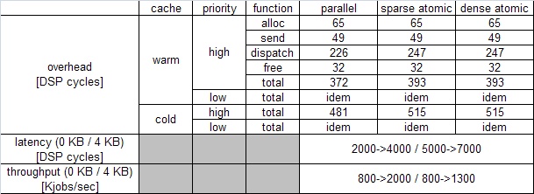
Micro Benchmarks
Minimum overhead
Measures minimum overhead per event in lowly loaded system (long events)
Minimum latency
Measures minimum latency from schedule request to receive in lowly loaded system (long events)
For payloads of 0 KB / 4 KB
Maximum throughput
Measures throughput in highly loaded system (short events)
For payloads of 0 KB / 4 KB

Slide 49
Macro Benchmarks: speedup
Measures multicore speedup in fully loaded system
Speedup =
sequential execution time /
parallel execution time with ovh1+ovh2+ovh3+ovh4
Overhead
ovh1: OpenEM overhead
Cycles spent executing OpenEM services
Dispatching, freeing, allocating, sending
ovh2: OpenEM stalls
Cycles spent waiting for the next event
Processing not long enough to hide scheduling and pre-loading latency
ovh3: cache coherency overhead
Cycles spent waiting for the completion of cache coherency operations
Invalidating consumed data if pre-loading disabled
Writing back produced data if post-storing disabled
ovh4: memory stalls
Cycles spent waiting for completion of read/write operations

Slide 50
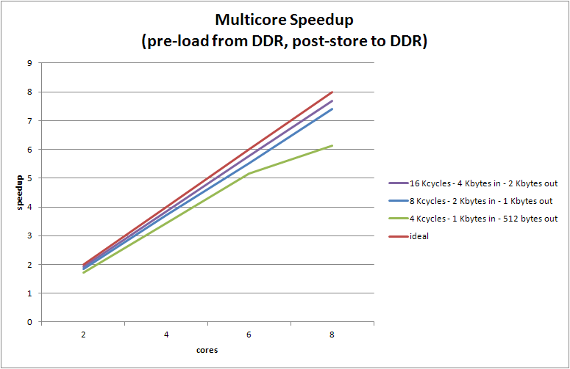
Macro Benchmarks: results

Slide 51
Questions?

